Slide 1


BA820
Team 6
Xiaoqi Hu, Fernanda Lin, Haolan Ma, Chenhang Niu, Yi Yu
Credit Card Segmentation : Tapping Unmet Consumer Needs

Slide 2
OVERVIEW
8950 Customer’s data with 18 variables within a 6-month period
Contains account information
DATASET: Credit Card data from Kaggle
METHODOLOGY AND ANALYSIS:
UML Techniques
Defined Clusters Using PCA and K-means. 5 Components, 6 Clusters
Develop strategies to target customers and increase credit card sales
RECOMMENDATIONS
We will draw conclusions and make decisions based on their needs and trends.
MISSION: Increase Revenue

Slide 3
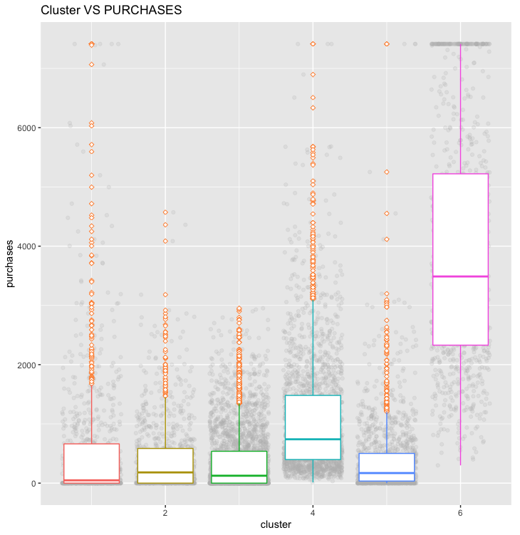
Variable Analysis for Each Cluster
Balance
Balance frequency
Purchases
One-off purchases
Cash Advance
Payments
Credit Limit +
Notes:
After we got the clusters from the k-means, we do the variable analysis for each cluster with box plots similar shown here.

Slide 4
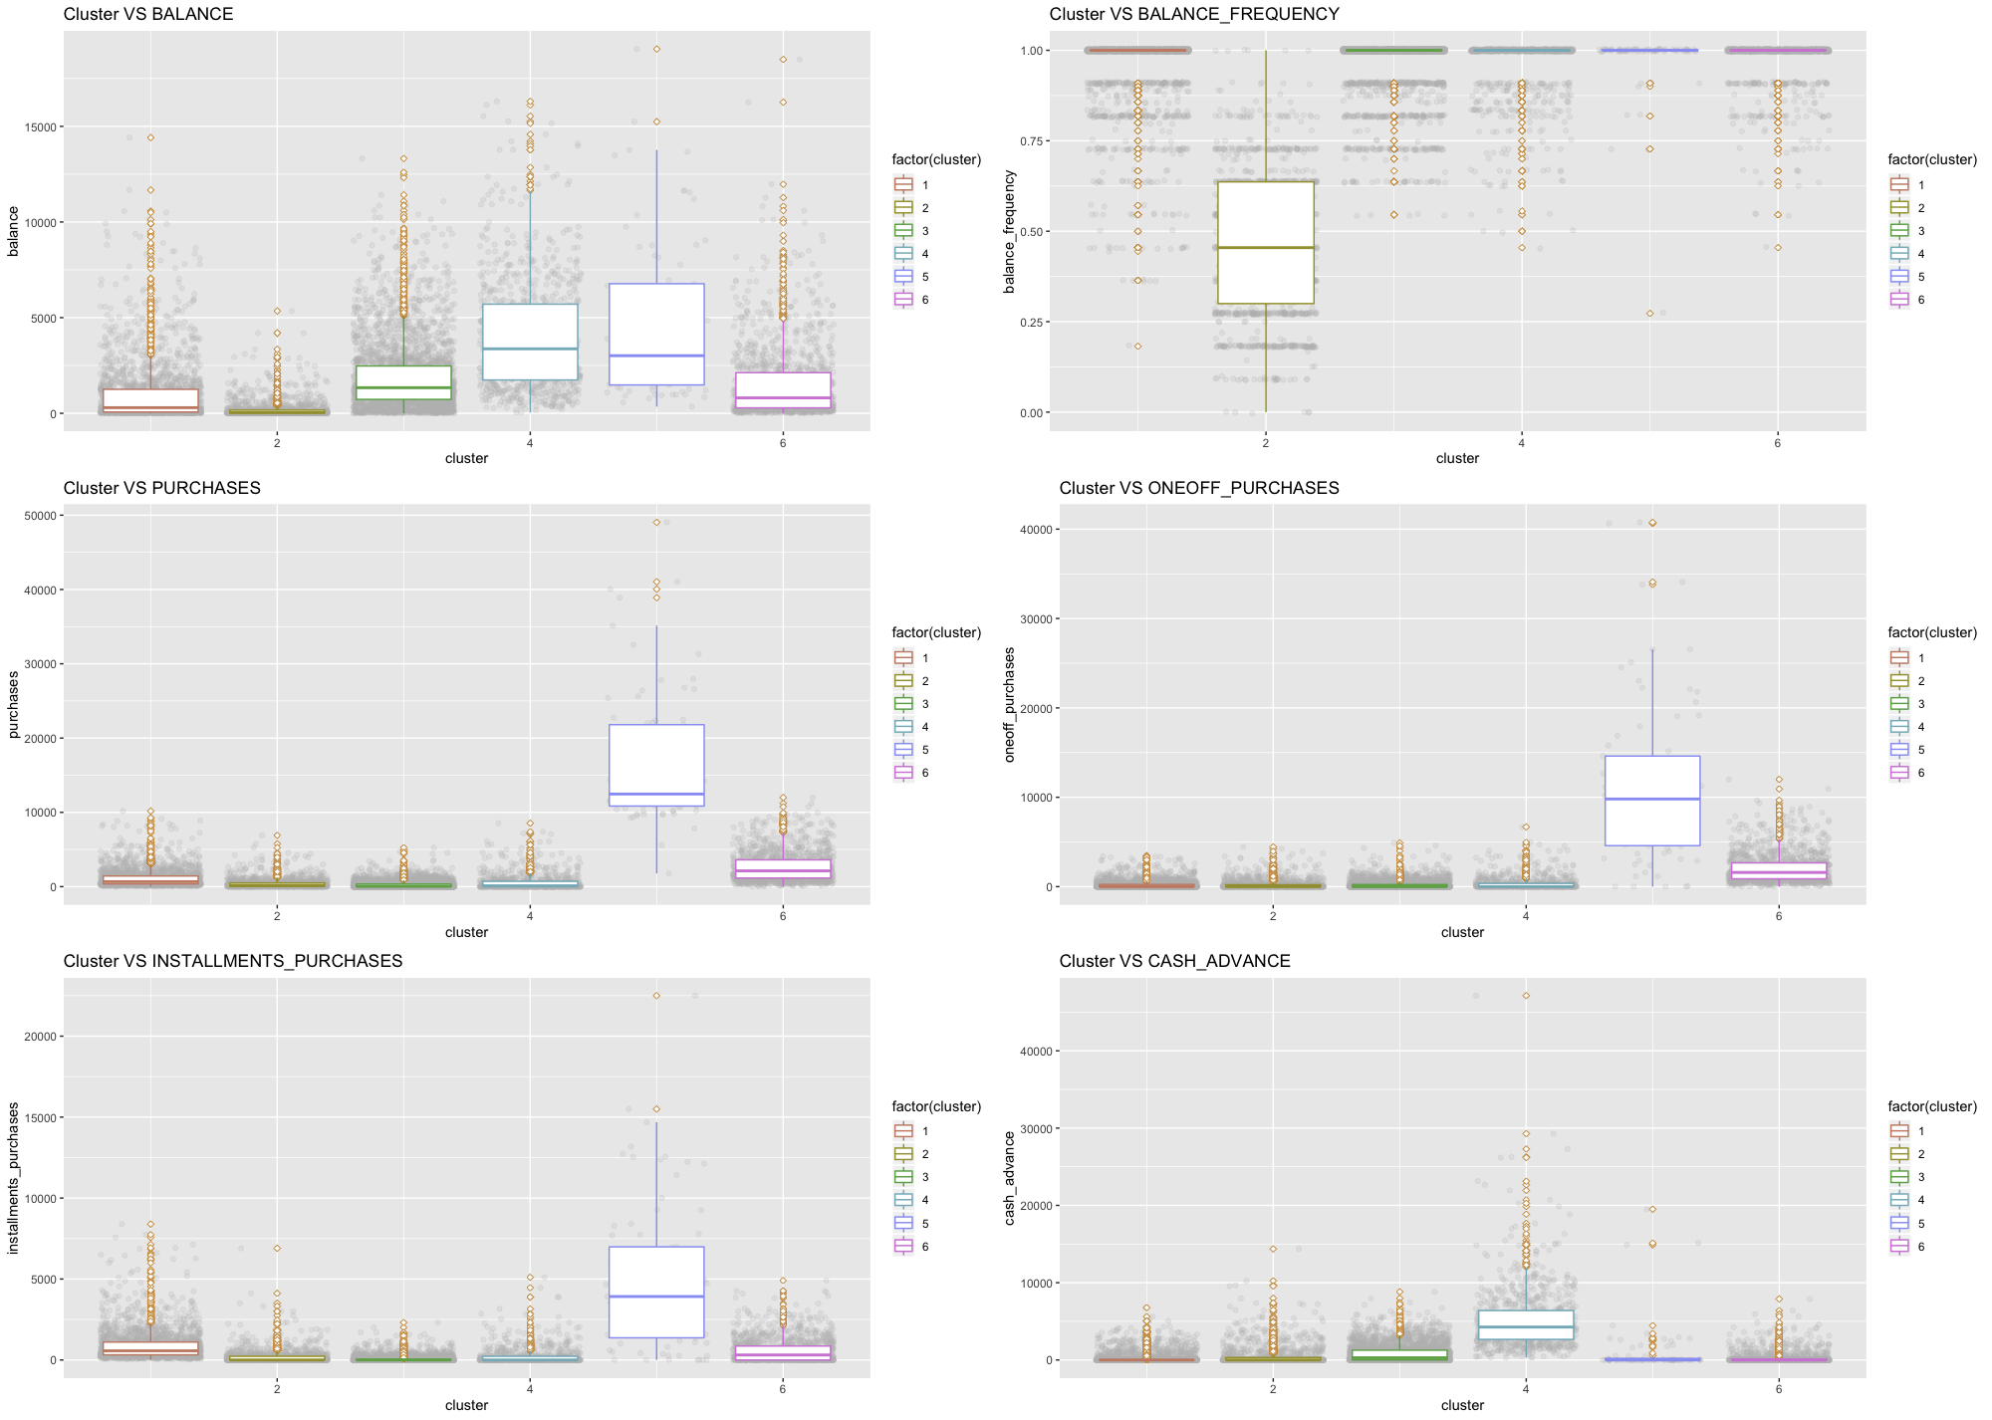
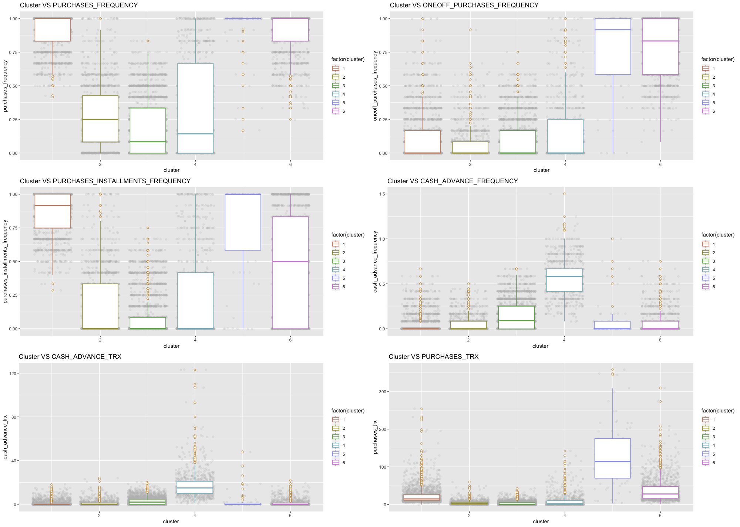
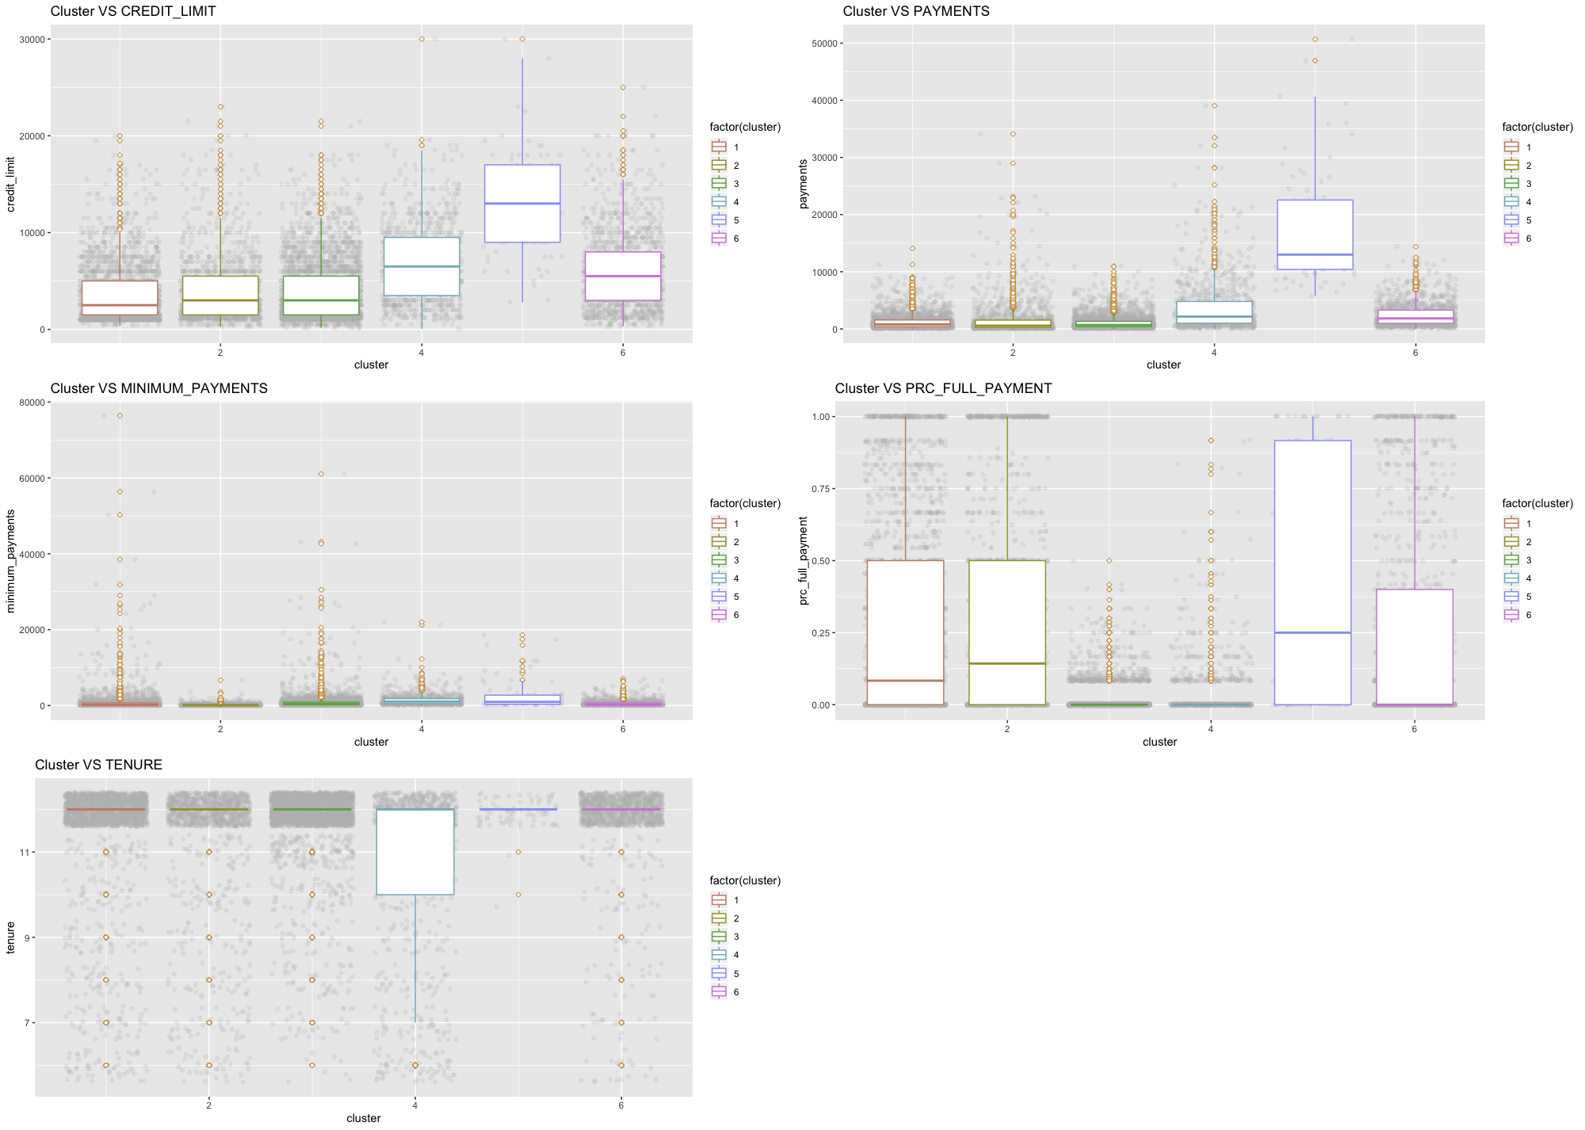



Summarize Variables
for
Clusters
Balance
Frequency
Credit
Limit
Purchases
$ 917
88%
$ 4453
Notes:
Then by summarizing all the variables for each clusters, we formed the cluster analysis.

Slide 5






Decoding the Clusters
1 The Subprime Customer
2 Self-aware Avoiders
3 The Average Joe
4 The Cash Borrower
5 Big Spenders
6 The Platinum Class

Slide 6
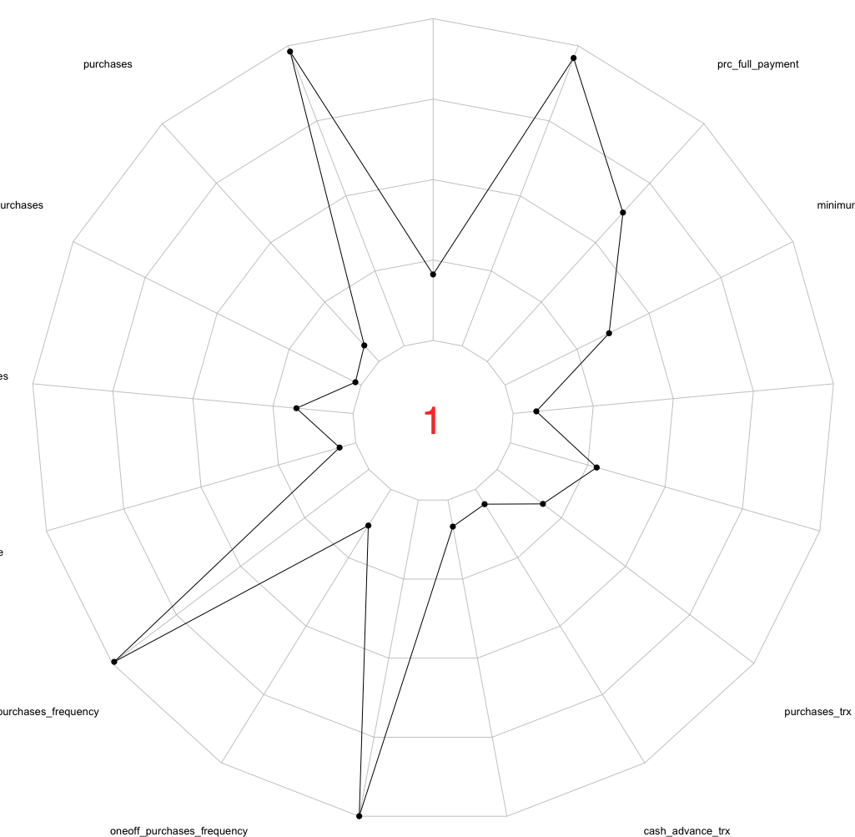

Cluster 1:
The Subprime Cluster
balance
balance_frequency
tenure
purchases
prc_full_payment
Increase interest rate
Decrease credit limit
Charge extra interest rate for extra credit limit
Check credit rate
Issue unsecured credit cards
oneoff_ purchases
minimum_
payments
installemt_purchases
payments
cash_ advance
credit_limit
purchases_frequency
purchases_trx
oneoff_ purchases_ frequency
cash_advance_trx
puchases_ installments_
frequency
cash_advance _frequency

Slide 7
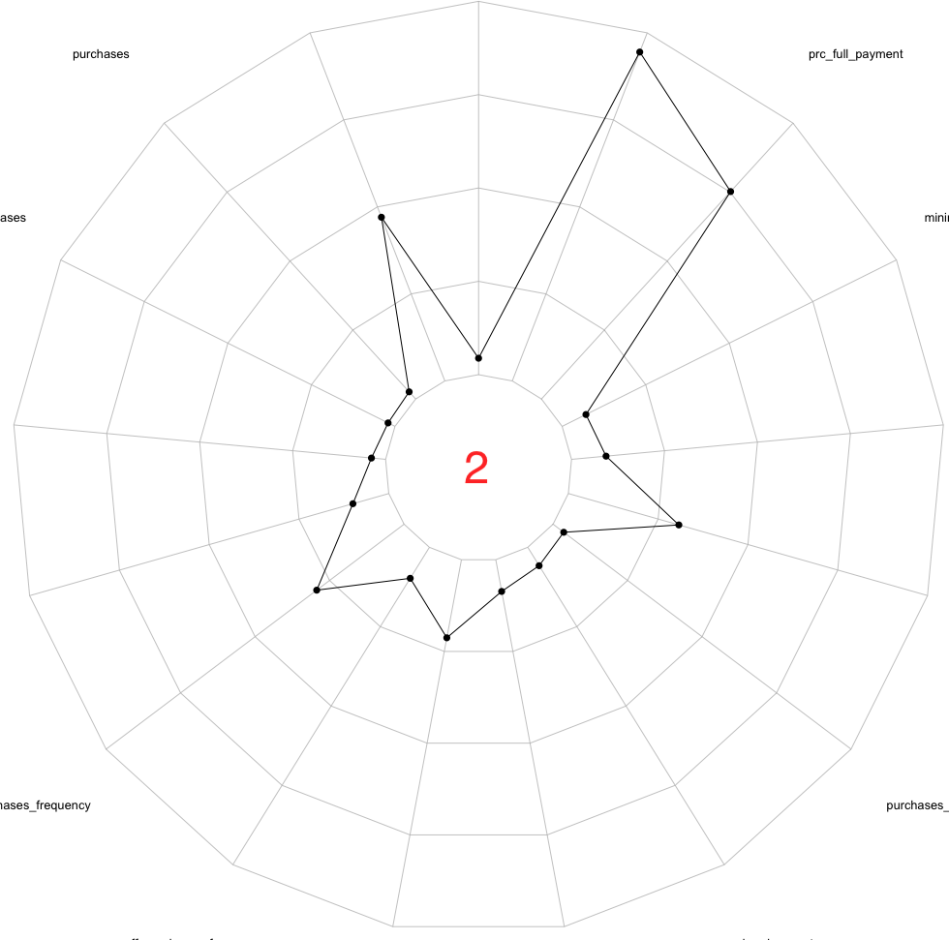

Cluster 2:
Self Aware Avoider
balance_frequency
balance
tenure
purchases
prc_full_
payment
oneoff_ purchases
minimum_
payments
Purchase Encouragement
Cash reward policy
installemt_purchases
payments
cash_ advance
credit_limit
purchases_frequency
purchases_trx
oneoff_ purchases_ frequency
cash_advance_trx
puchases_ installments_
frequency
cash_advance _
frequency

Slide 8
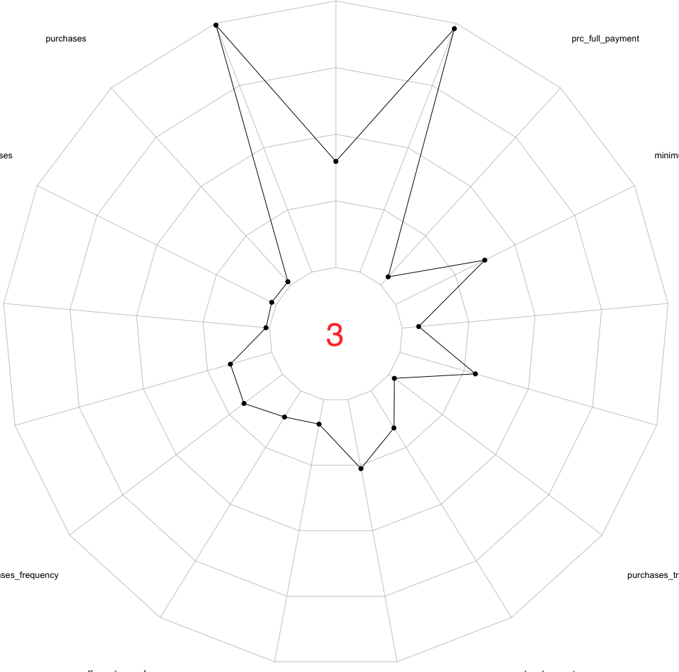

Cluster 3:
Average Joe
balance_ frequency
balance
tenure
purchases
prc_full_ payment
Cash back
Incentivise current customers
Implement late fees
oneoff_ purchases
minimum_
payments
installemt_purchases
payments
cash_ advance
credit _limit
purchases_ frequency
purchases _trx
oneoff_ purchases _frequency
cash_ advance_trx
puchases_ installments _frequency
cash_ advance_ frequency
Notes:
spends moderately

Slide 9
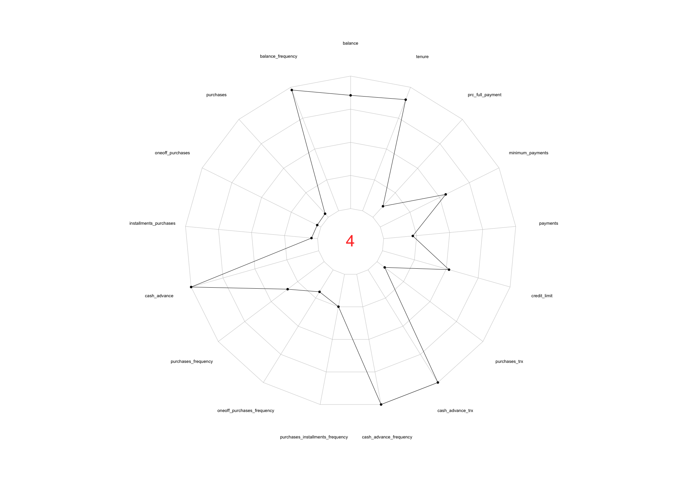

balance_ frequency
balance
Cluster 4:
Cash Borrower
tenure
purchases
prc_full_ payment
oneoff_ purchases
High Interest Rate
Set Maximum Credit Limit
minimum_
payments
installemt_ purchases
payments
cash_advance
credit_limit
purchases_ frequency
purchases_trx
oneoff_purchases_
frequency
cash_advance_trx
puchases_installments_frequency
cash_advance _frequency
Notes:
need to first introduce the term “cash advance”. Cash advance is a service provided by credit card issuers that allows cardholders to withdraw cash up to a certain limit.
cluster 4 like to do cash advance a lot.
Besides, they have other extreme characteristics: that means they use their cards to do many transactions for just cash advance for many years.
“cash borrowers”. They always need money but they do not have money at the same time, so they use cash advance on credit card as a way to make loan.
pay more attention on these users because they can potentially make huge profits and risks at the same time. On one hand, most of these users can pay back on time, so issuers can make profits from charging high interests and fees.
On the other hand, taking the risks of losing principals. Although there are only few payments that cannot be repaid, one non-repaid payment could cause big loss to issuers.
plan: charging a higher interest rate and setting a maximum credit limit. With this strategy, users can still increase the credit limit with strong repayment ability, but if they do cash advance for many times, the credit limit will not be raised once it reaches the maximum credit limit.
Credit card issuers can gain profits from cash advance with less risks in this way.

Slide 10
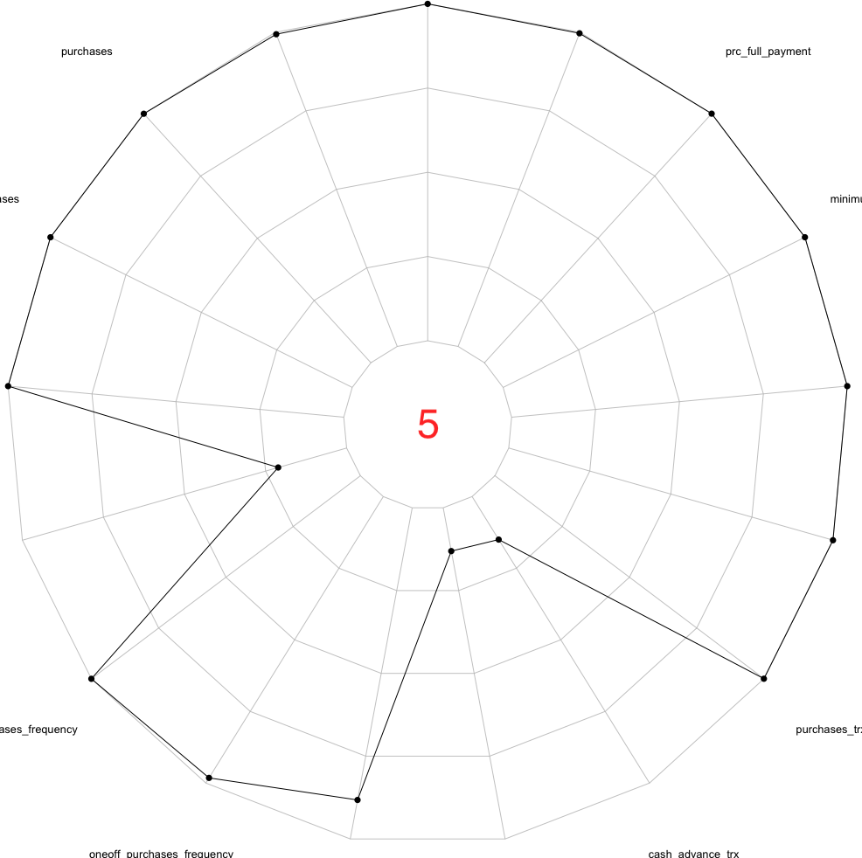

Cluster 5:
Big Spenders
balance
balance_frequency
tenure
purchases
prc_full_payment
Differentiate Services (personal tailored),
Cancel service fee (Annual fee),
Lower interest rate.
oneoff_purchases
minimum_
payments
installemt_purchases
payments
cash_advance
credit_limit
purchases_
frequency
purchases_trx
oneoff_purchases_
frequency
cash_advance_trx
puchases_installments_ frequency
cash_advance _frequency

Slide 11
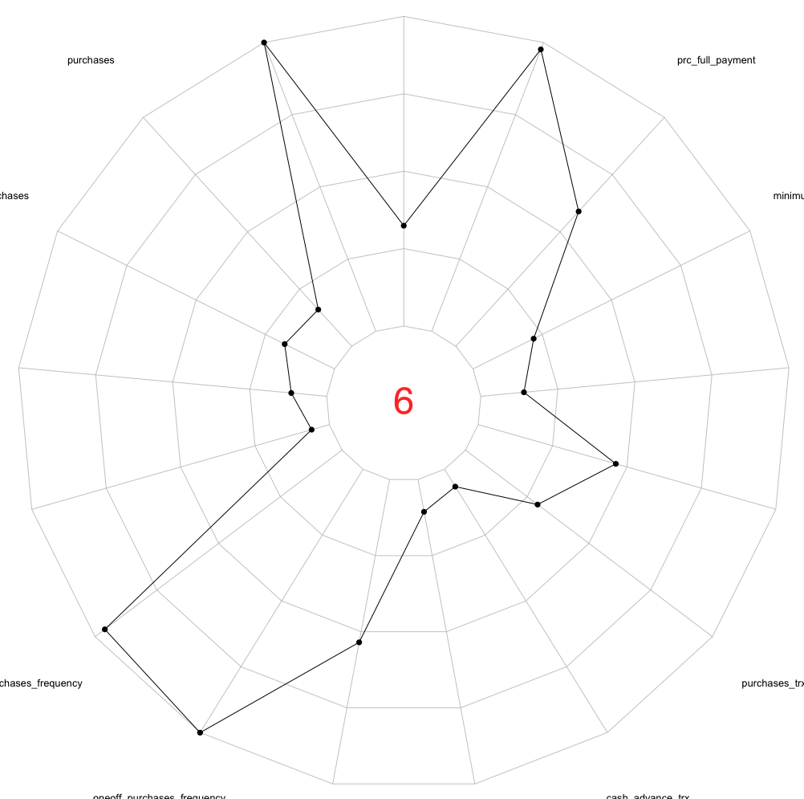

balance
Cluster 6:
The Platinum Class
tenure
balance_frequency
prc_full_payment
purchases
oneoff_
purchases
minimum_
payments
Raise credit limit
Promot platinum card
Reward program
installemt_
purchases
payments
cash_
advance
credit_limit
purchases_
frequency
purchases_trx
oneoff_purchases_frequency
cash_advance_trx
puchases_installments_frequency
cash_advance _frequency

Slide 12

Conclusion
Drive Revenues and Growth
Revenue Leakage
Business Objectives
Needs-based segment, differentiated service attract new customer & service
Optimize scoring efficiency
Clarify positioning and promotions

Slide 13

THANK YOU!

Slide 14
